Slide 1
Prinect Anwendertage, 8. und 9. November 2013
Faltschachtel- und Etikettenproduktion mit Prinect
Sabine Roob

Slide 2
Komplette Lösung für Faltschachteln & Etiketten im Offsetdruck – vom Design bis zur Weiterverarbeitung!
Gleicher Workflow wie für Akzidenzen, aber mit speziellen Verpackungsfunktionen!
Der einzige komplett integrierte Workflow für Verpackungen
Weniger Fehler, kürzere Rüstzeiten und weniger Makulatur in Druck und Weiterverarbeitung
Spitzenqualität, zu jeder Zeit wiederholbar!
Mehr Transparenz & Kostenkontrolle
Notes:
So we modified and enhance Prinect since 2008 to fulfill as well the requirement for folding box and label production.
The advantages of Prinect integration are more or less the same like for commercial, but in packaging production even more important. High production volume with a lot of repeat jobs and legal specifications for food and pharmaceutical packaging require industrialized production and control.

Slide 3
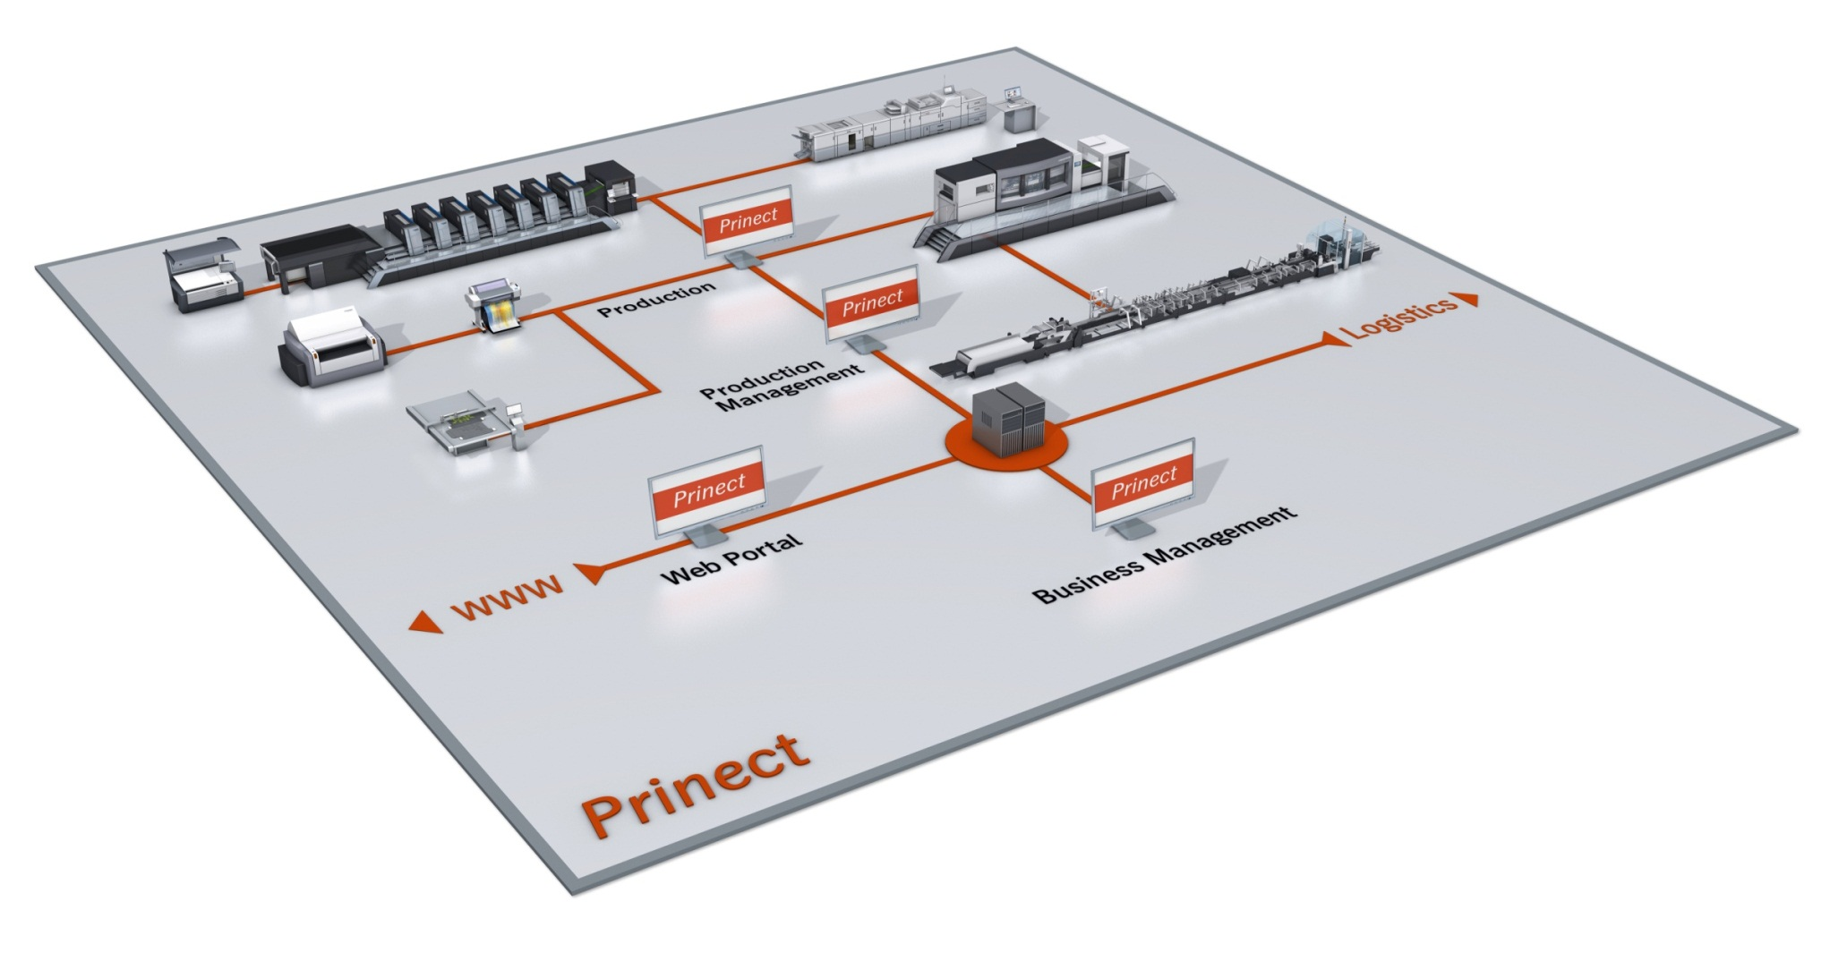
Prinect, der integrierte Druckereiworkflow
Packaging Print Workflow
Notes:
This model of a completely integrated print shop is familiar to you.
Like for commercial all areas are connected via Prinect in one combined system and work on same data. (Show red lines to central server)
Especially for packaging we have added the structural design – symbolized by the cutting table. And of course in finishing we have die cutters and folder-gluers.
Dedicated packaging terminology and administration structure are implemented.

Slide 4
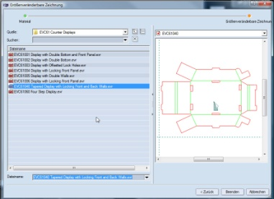
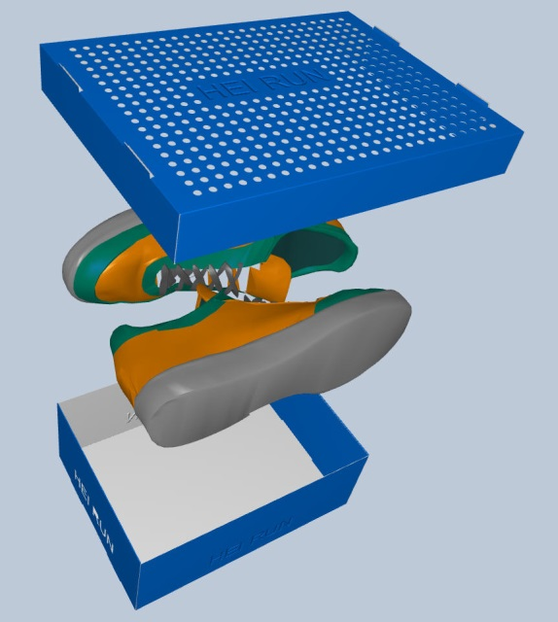
Schnelle, einfache Entwürfe, Layouterzeugung und Werkzeugdesign
Prinect Package Designer
Schnelles, fehlerfreies Design von Verpackungen und Displays
3D Softproofs für schnelle, kostengünstige Kommunikation mit Kunden
Illustrator Plug-in zur einfachen, genauen Erstellung des Grafikdesigns
Effiziente Layouterzeugung
Kostenreduzierung in der Produktion
Exakte Informationen für die Kostenkalkulation im MIS – ohne Opetratoreingriff!
Präsentationen\Movies\Film_Illustrator_NEU.wmv
Notes:
For creation of drafts we offer with Prinect Package Designer a CAD – Computer Aided Design – Software that is completely integrated into the Prinect Workflow. Parametric design allows the automatic creation of the structural design. Libraries with more than 1500 ready-to-use drafts for packages, tablets, displays etc. including all ECMA- und FEFCO-Standards only need the individual dimensions. Parametric components drastically reduce production time of individual products and make the design absolutely reliable.
The result can be checked in 3 D view. This interactive PDF can also be provided as softproof for the customer. Since Prinect 2013 the 3D simulates as well refinement effects like embossing, metallic foils and so on. This saves costs and speeds-up the approval process.
Graphic design is not the competence of Heidelberg and also not of our customers. But of course we want to ensure that the graphic design fits optimal to the shape and can be prepared for printing in prepress. So we not only export the data in all common formats as PDF, EPS oder Adobe Illustrator but we also offer an Illustrator-Plug-In. Please see a short video showing how it is possible to work directly on the 3D data. As you can see it is for example possible to exactly position an object over edges – also, if the single areas lie not directly next to each other in the flat draft.
It is already here in Prinect Package Designer where the following production costs are considered: sheet layouts are created with minimum waste. Herebye different machine formats can be compared. And of course the layout can be used for creation of die cutting tools, if required. Since version 13 nesting of different shapes can be calculated automatically. This is especially for label gang forms a great help!
Besides the box type and the exact dimensions are forwarded to be used as presetting data at the folder gluer to reduce make-ready and waste and to make the processing more exact.
Integrated with Prinect and a packaging dedicated MIS – e.g. Boxsoft – Package Designer delivers all the info for estimation. If standard box designs are used, this can happen even automatically without any user interaction.

Slide 5
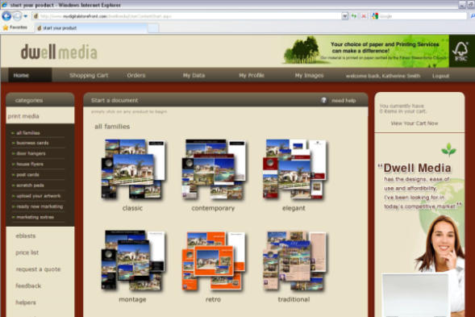
Verschiedene Bestellarten
Artikel können auf verschiedene Arten bestellt werden:
Manuelle Anlage einzelner Jobs mit ein oder mehreren Artikeln im MIS/ERP oder Prinect Cockpit
Bestellung über eine Excelliste (Menge je Artikel etc.)
Übersetzung in csv-Dateien
Jede Zeile wird ein Job im Cockpit
Jobs können zu Sammelaufträgen zusammengefasst werden
Bestellung über einen Webshop
Notes:
Ordering of new articles can be done like in commercial in the standard way or via web-to-print. But for label production often excel lists with many different articles with different amaounts are delivered by the print buyer. In this case it is not necessary to type in the orders manually, but the excel list can be converted to a csv-file which creates automatically the Prinect jobs with the required data. That can save a lot of time and avoids mistakes due to wrong capturing of the amounts.

Slide 6
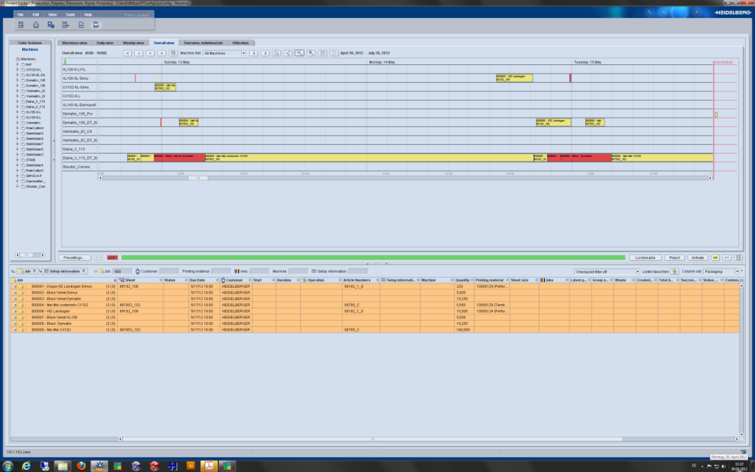
Integrierte Produktionsplanung und -kontrolle Prinect Scheduler
Elektronische Plantafel
Kompletter, aktueller Überblick
Optimale Kontrolle, schnelle Reaktion
Reduzierung der Rüstzeiten
Notes:
For the intelligent production planning Prinect Scheduler – the electronic planning board – can be used. Checkpoints for material and tool availablity can be used as an early-stage warning tool if plates, carton or tools are not available at a certain time to react in time and reduce down time.
It is also possible to sort jobs within a specified time frame regarding print color, die cutting tools or box types – group them and plan them one after the other to reduce set-up times at the machines drastically. This often results in much more time saving than any other action.

Slide 7
Pre Press Prinect Prepress Manager and PDF Toolbox
PDF-basierter Workflow zur druckgerechten Einzelnutzenaufbereitung
Prinect Prepress Manager für automatische Bearbeitung
PDF Toolbox für leichtes Bearbeiten von PDF-Daten
Überprüfung des grafischen and stukturellen Designs
Neue plug-ins wie Barcode und Object Editor
Alle Informationen werden gespeichert für Wiederholaufträge in gleicher Qualität
movies\PDFTB P12 new features.avi
Notes:
In Prepress it is necessary to check, if graphic and structural design fit exactly together. Therefore we enabled PDF Toolbox to import as well CFF2 data, so that we can place the two designs on to of each other and check that they fit.
For interactive one-up preparation we added new plug-ins e.g. to exchange EAN or other barcodes to ensure their ligability. Since version 13 as well two-dimensional codes QR and Datamatrix are supported, which are often used on packages and labels to link the user to the according web site with more info about the product.
In packaging more spot colors and refinements are required. That was the reason to develop the object editor. Together with the color and coating editor it allows fast creation of new separations as well as modification of object features.

Slide 8
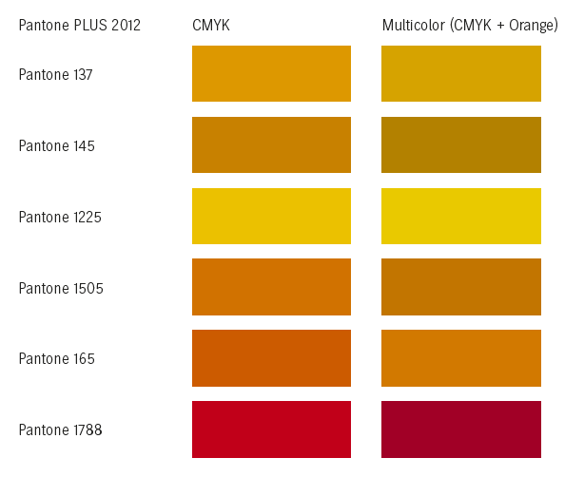
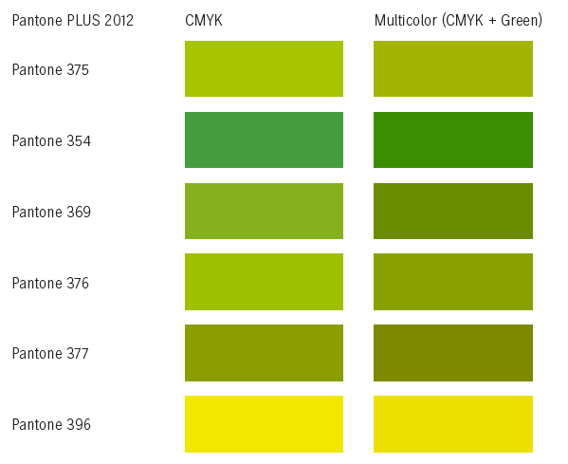
Multicolor zur Reduzierung von Sonderfarben
Intelligenter Ersatz der Sonderfarben durch CMYK plus Orange, Grün und Blau
Weniger Farbwechsel, weniger Waschvorgänge, stark reduzierte Rüstzeit!
Geringere Maschinenstillstandzeiten
Weniger Lagerbestand von Sonderfarben
Sonderfarben müssen nicht für Anicolor qualifiziert werden
Höhere Prozesssicherheit durch einheitliches Farbverhalten
Notes:
To reduce the costs, especially if you print many short runs, Heidelberg offers spot color replacement with Multicolor. Approx. 80% of Pantone and HKS colors can be simulated with CMYK plus orange, green and blue. The Prinect software calculates the replacement and the quality of the result. You decide what is good enough!

Slide 9
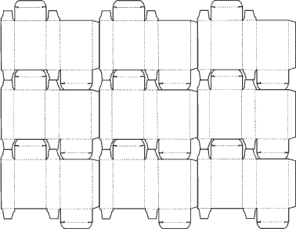
Bogenvorbereitung Prinect Signa Station Packaging Pro
Effektive Druckbogenaufbereitung
Im- und Export aller CAD-Formate
Step & Repeat mit Verschnittminimierung
Sammelformerstellung
3D-Modell: Virtueller Proof für strukturelles Design
Beschnittpfad-Definition
Intelligentes Markenhandling
Barcode-Erzeugung
Erzeugung der Voreinstelldaten für Druck und Weiterverarbeitung
Schnelle Bogenaufbereitung
Kürzere Rüstzeiten für Druck und Weiterverarbeitung
Notes:
Sheet preperation takes place in Prinect Signa Station. For the special requirements for pacaking many new features were implemented with the option Packaging Pro in 2008. Here all common CAD data formats can be imported and - if requested- be converted into other formats. In case there is no layout, this can be created easily with efficient step and repeat functions.
As in Prinect Package Designer also here a 3D softproof of each individual one-up can be created. This interactive PDF can be sent to the customer via Remote Access or Email. The customer only needs an Acrobat Reader.
Printing free areas can be specified with a few clicks using the clip path function.
Marks and control elements can be added. Space-saving minispots for color control at the printing machine, waste numbers for the fast set-up at the die cutter as well as barcodes and glue flap codes are very useful for packaging printers. The exact data is sent as presetting data to the machines and therefore reduces the set-up times.

Slide 10
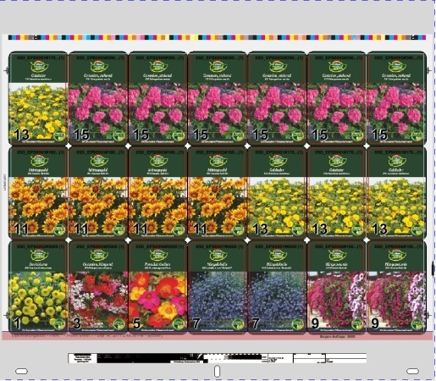
Bogenoptimierung für Sammelformen Prinect Signa Station Sheet Optimizer
Automatische Positionierung mit Platzoptimierung und Überproduktionsminimierung
Verteilung auf CAD-Layout oder leerem Bogen
Optimierung basierend auf Produktionskosten inkl. Unterstützung mehrerer Bögen
Erfolg: drastische Einsparungen bei Platten und Rüstzeiten!
movies\Optimizer.wmv
Notes:
If several articles with different run lenghts shall be printed as gang form, the optimal sheet layout can automatically be calculated. These articles can be positioned on the layout.
As you can see in this short video this is also possible with name conventions without a compete Prinect system.
In case of rectangular one ups, for example labels, these are distributed freely considering the ability to be finished at the die cutter. Upon request the articles can also be distributed over several sheets. The decision, how many sheets are produced is based on cost parameters.
With the intelligent creation of gang forms plate costs and set-up times can be reduced drastically.

Slide 11
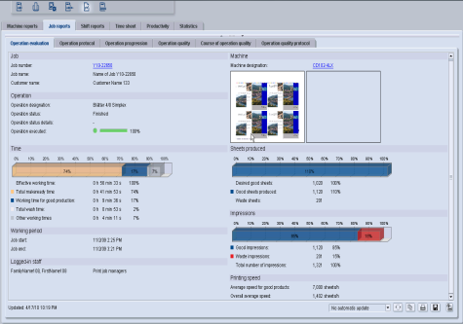
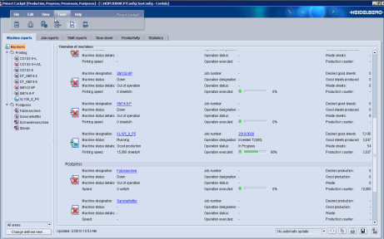
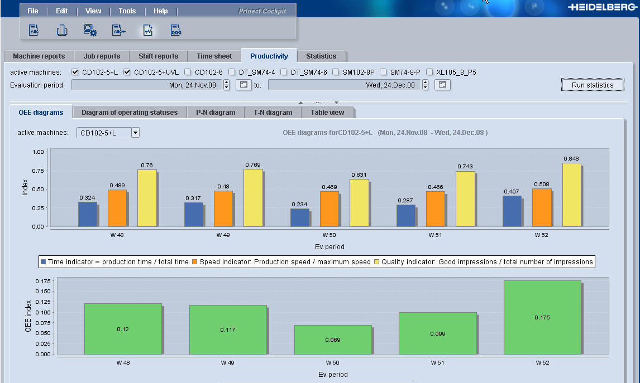
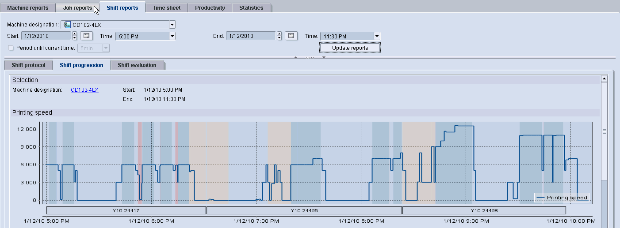
Druckintegration Prinect Pressroom Manager
Übernahme der Voreinstelldaten aus MIS/ERP und Prepress
Schnelles Rüsten
Online-Rückmeldungen der Maschinen
Exakte Daten für die Produktionsanalyse und Nachkalkulation
Prinect Mobile und Prinect Performance Benchmarking weltweit
Exakte Berichte helfen, den Workflow zu optimieren
Notes:
After plate output, we come to printing.
I assume you all know Pressroom Manager. It´s reporting tools are even more important in packaging since there are often repeat jobs. Prinect Manager does not only safe time by providing all info from the previous job, but ensures as well same quality. And with Analyze Point you can check each job or customer to make sure to have highest profitability.

Slide 12
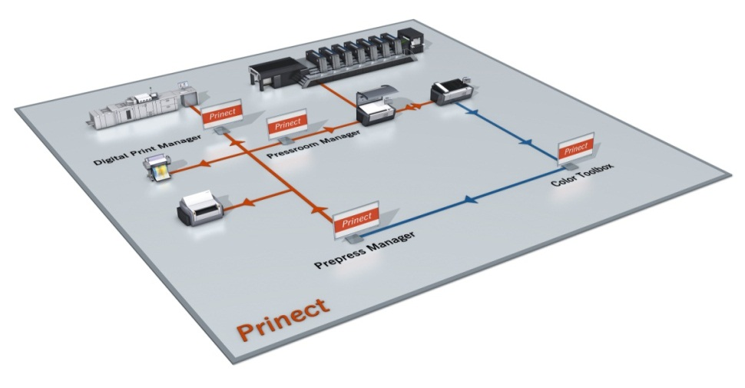
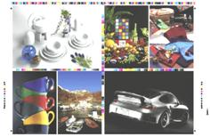
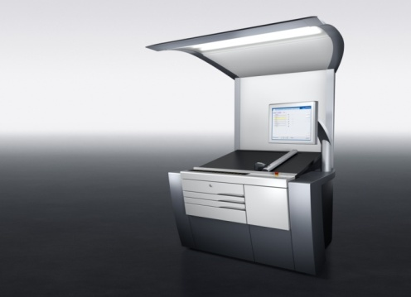
Farb- & Qualitätsmanagement
ICC-Profilberechnungen
Integriertes Colormanagement im Druck
100% Checks
Topqualität – stabil und jederzeit wiederholbar!
Notes:
To ensure highest quality in printing, different measuring tools for inline and offline measurements are used to directly control color.
100% control by scanning of each separate sheet and comparison with one „ok-sheet“ or released PDF are very helpful especially for printing pharmaceutical or luxary packages.
The results can be forwarded as quality reports. All machine setups are saved together with the job data and are directly available for repeat orders.

Slide 13
Weiterverarbeitungsintegration Prinect Postpress Manager
JDF-Daten von MIS/ERP und Prepress werden in Voreinstelldaten übersetzt
Schnelles Rüsten
Online-Rückmeldungen der Maschinen
Exakte Daten für die Produktionsanalyse und Nachkalkulation
Prinect Mobile: Überblick über den Status aller Aufträge von überall
Exakte Berichte helfen, den Workflow zu optimieren
Notes:
As in printing, all integrated finishing machines receive all job data and make-ready information.
At the Dymatrix die cutter the feeder can be set up automatically. Besides the corresponding toolset number is provided. Waste numbers on the print sheet can help during set-up.
Diana folder gluer receives box type and dimensions, so that with Autoset the modules can be set-up accordingly. This reduces the set-up time only slightly as the reconstruction of the modules takes most time, but it increases the accuracy.
But much more important in finishing is production and cost transparency. The feedback analysis for re-calculation and numerous reports is highly appreciated to see if the production was cost-effective.
All machines which can not be integrated online as they have no electronic control or come from other providers, can be integrated into the workflow via data terminals. This means, the operator transfers the data between machine and the data terminal integrated in Prinect.

Slide 14
Prinect Anwendertage, 8. und 9. November 2013
Vielen Dank für Ihre Aufmerksamkeit!
Sabine Roob
Notes:
Well, I hope that gave you a good impression on how Prinect can help to extend your business as well in direction of folding boxes and labels. Sebastian will show now a live example. If you have any questions, please ask directly. We are open for any discussion.
Thank you very much for your attention.

